Slide 1
DOM XSS jQuery
Fahad Choudhury

Slide 2
Problem with jQuery
jQuery will evaluate <script> tags when an HTML string is passed into it. Makes XSS easier than if you use native methods.
For example the following will show an alert:
<script>alert("alert")</script>
However, do the same thing using the browsers native innerHTML, and nothing happens
The native browser functionality is to ignore <script> elements that added via an HTML string
Demo should show two alert tags but innerHTML won’t work

Slide 3
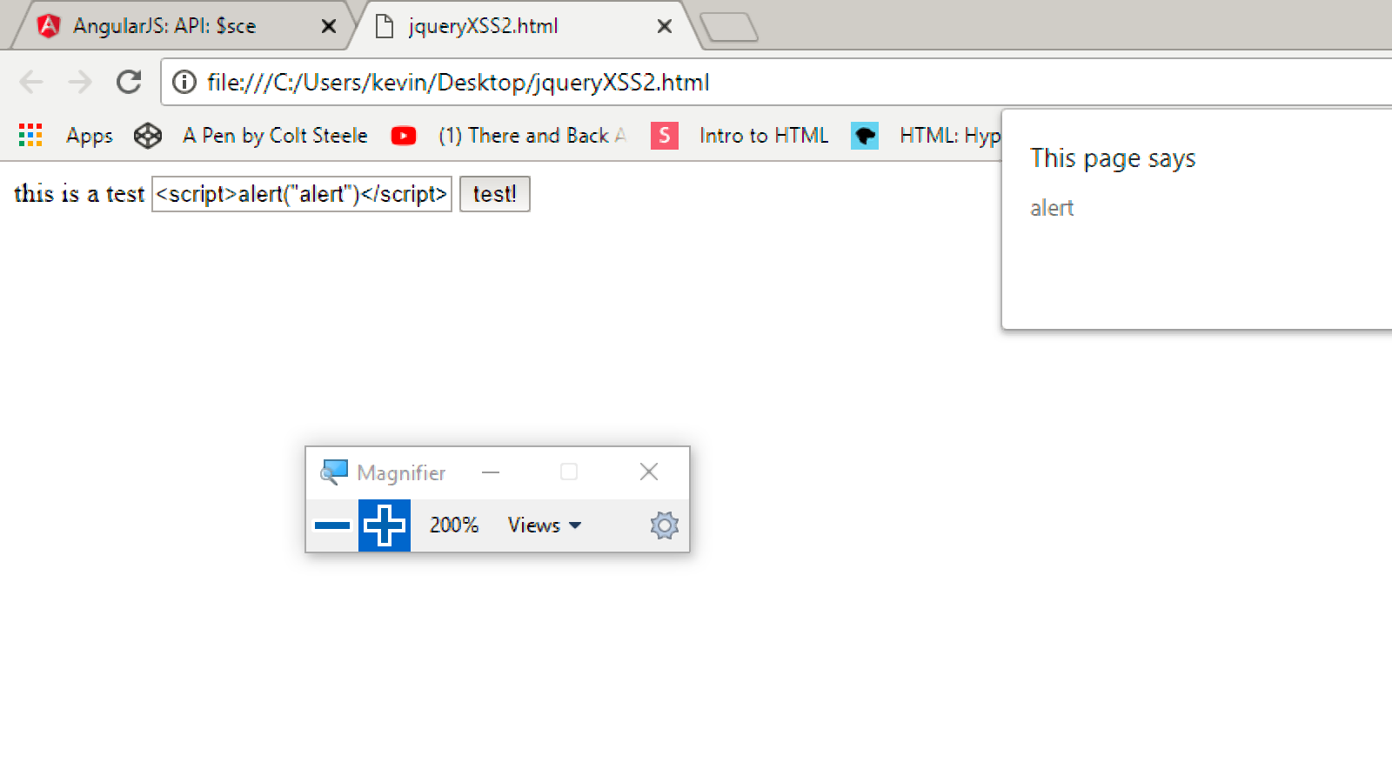
<script>alert("alert")</script> jQuery will run the script while native html coding reads it as a string

Slide 4
Work-around
Script pseudo-protocols can be used in various locations to execute inline script
For example: <iframe src=javascript:alert(1)>
This attack is effectively the same as a conventional XSS attack; the attacker simply uses the src attribute of the injected iframe element as a vehicle to run some javascript code in the attacked page.

Slide 5
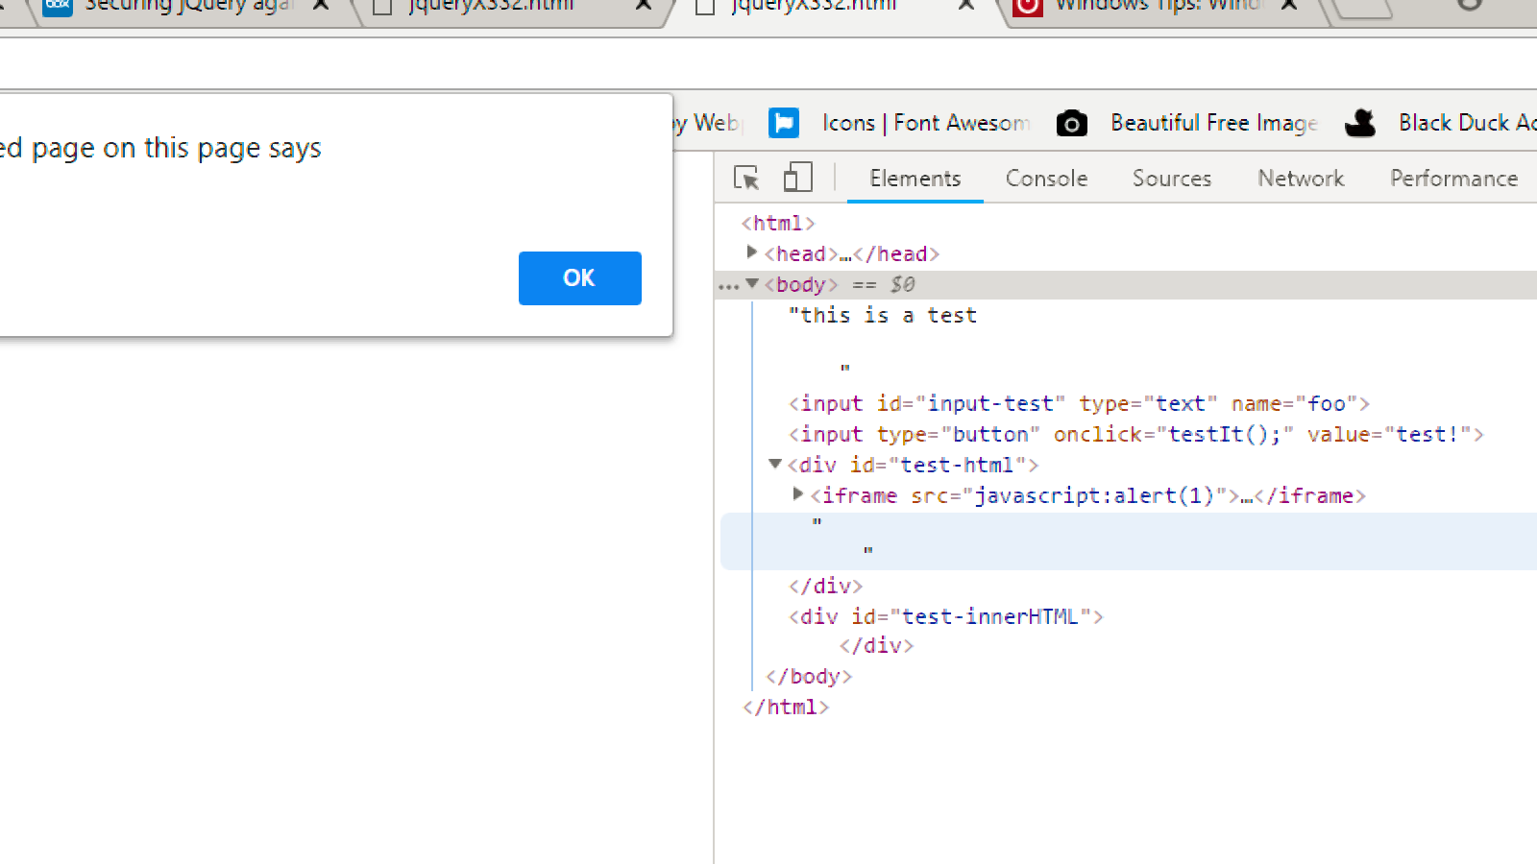
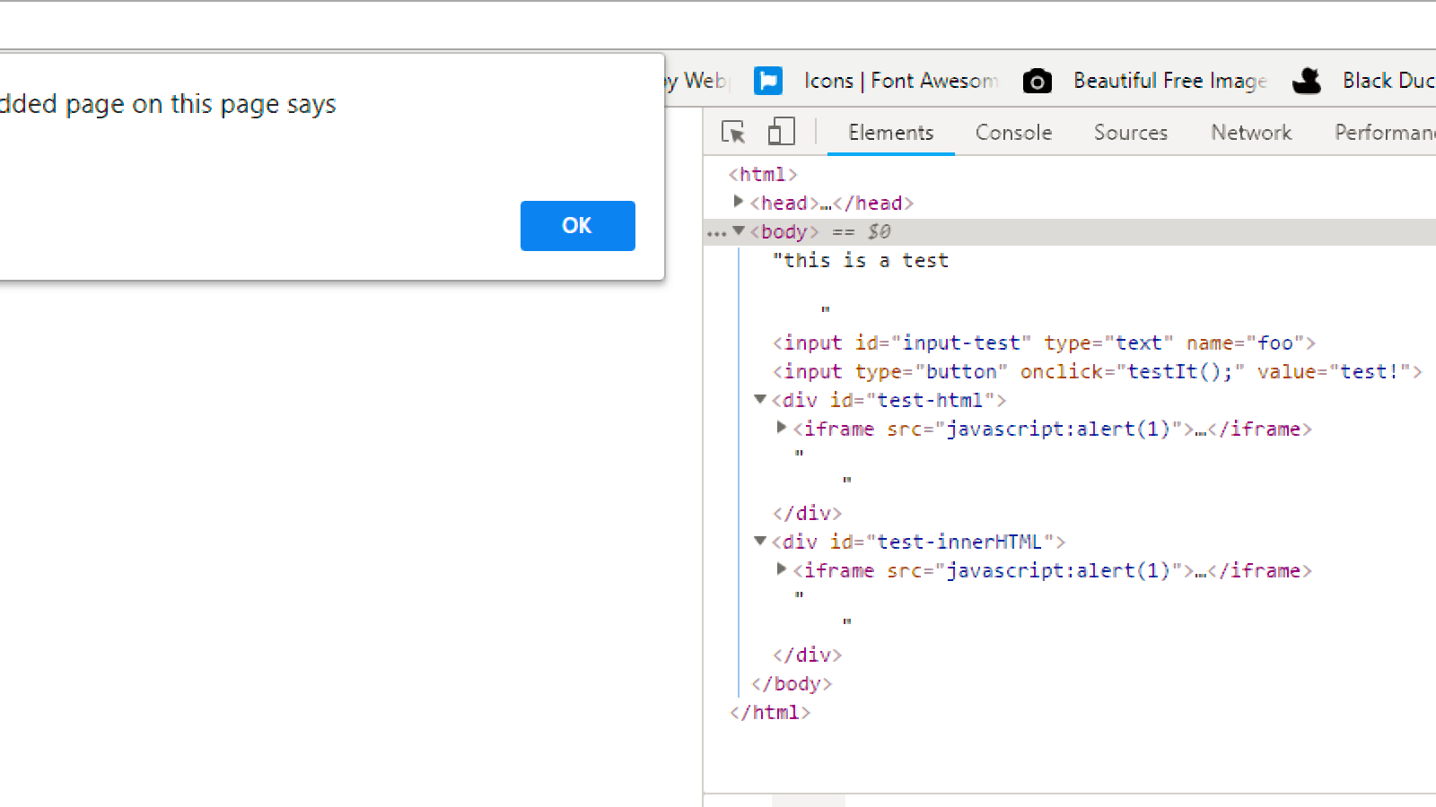
<iframe src=javascript:alert(1)> Will show both alert boxes bypassing the innerHTML

Slide 6
DOM XSS AngularJS

Slide 7
Trust and Insert entire HTML:
Use $sce service and call trustAsHtml method which then inserts entire HTML into the DOM. We are whitelisting
Strict Contextual Escaping (SCE) is a mode in which AngularJS constrains bindings to only render trusted values
ng-model you can bind the value of an input field to a variable created in AngularJS.
AngularJS treats all values as untrusted by default in HTML
One code such as “<style>.hello{color:red}</style>” is inserted, it ended up painting already existing HTML element. This could deface a website with background images that may be illegal
Also because the style and img elements are being white listed, we can also upload any image with <img>

Slide 8
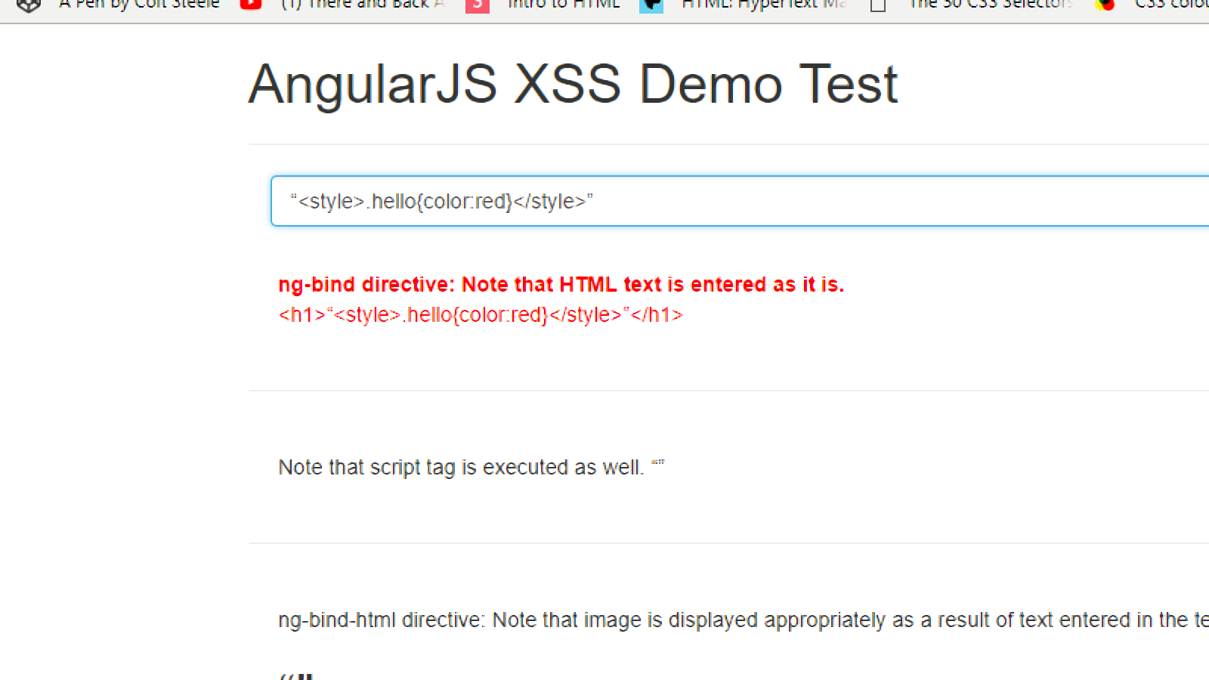
Changing the style of the page

Slide 9
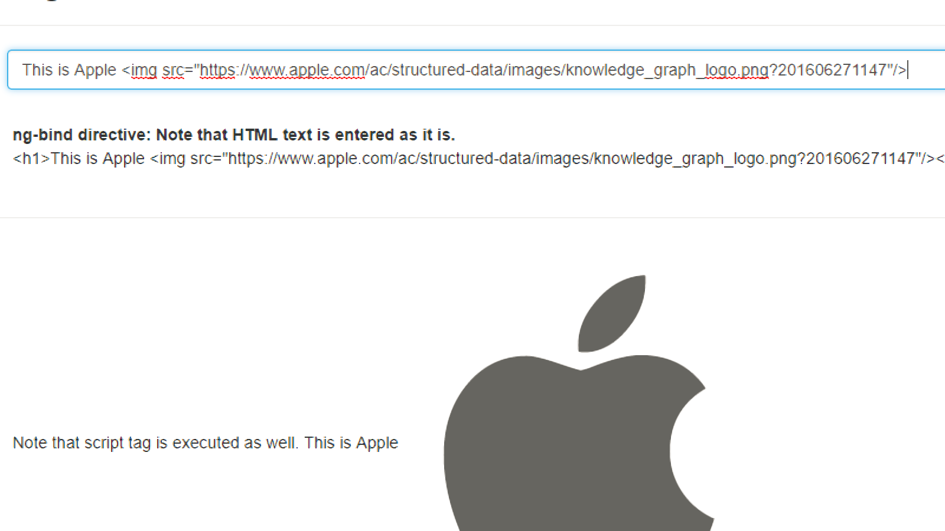
Inserting images on page

